Slide 1
To understand
Crossfilter
directions
To understand
Crossfilter
directions

Slide 2

Understanding Crossfilter Directions
Note: This lab uses the lab5.xlsx file in the Sales template
Go to "Model" (Model View ) in Power BI.
Connect the tables as follows:
DimProduct [ ProductID ] → FactSales[ ProductID ]
DimSupplier [ SupplierID ] → FactSales[ SupplierID ]
"Single" filter direction .
Simple Filtering (Single) :
Filtering DimProduct will only show sales related to that product.
Filter DimSupplier will not filter products.
Double Filtering ( Both ) :
Filtering DimSupplier will also filter DimProduct , allowing only
the products sold by a given supplier.

Slide 3
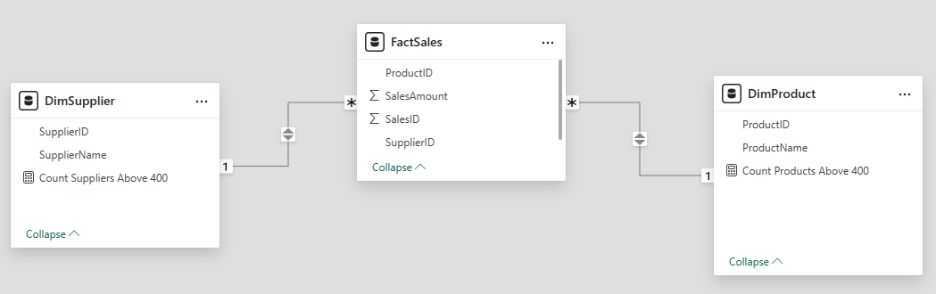
Understanding Crossfilter Directions
The filter can be specified with the DAX CROSSFILTER formula
CROSSFILTER ( DimProduct [ ProductID ], FactSales[ ProductID ], BOTH)
CROSSFILTER ( DimSupplier [ SupplierID ], FactSales[ SupplierID ], BOTH)

Slide 4
Understanding Crossfilter Directions
In DimSupplier to count the number of suppliers with sales above a threshold (eg: 400).
Count Suppliers Above 400 = CALCULATE( COUNT( DimSupplier [ SupplierID ]), FILTER(FactSales, FactSales[ SalesAmount ] > 400), CROSSFILTER( DimSupplier [ SupplierID ], FactSales[ SupplierID ], BOTH))
In DimProduct to count the number of suppliers with sales above a threshold (eg: 400).
Count Products Above 400 = CALCULATE( COUNT( DimProduct [ ProductID ]), FILTER(FactSales, FactSales[ SalesAmount ] > 400), CROSSFILTER( DimProduct [ ProductID ], FactSales[ ProductID ], BOTH))

Slide 5
Understanding Crossfilter Directions
Expected effect:
Single Direction mode , this metric will return the total number of suppliers , as FactSales
cannot filter DimSupplier .
In Both Direction mode , this metric will only return suppliers who have sold
for more than 400 .
How to test the effect of CrossFilter ?
Create an array with DimSupplier [ SupplierName ] and CountSuppliers Above 400
Compare the results by modifying the relationship DimSupplier ↔ FactSales
Single Mode : All providers appear.
Both Mode : Only suppliers with sales > 400 are counted.
Do the same for DimProduct and observe the changes.

Slide 6
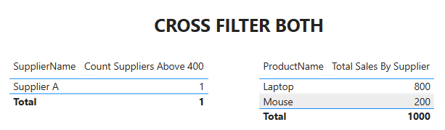
Understanding Crossfilter Directions

Slide 7
THANKS
THANKS

